Slide 1
Hospital Database
By Alex Dela Cruz and Inuka Hulathduwage

Slide 2
Application Background
Centralizes patient and staff records
Quick access to medical history and billing
Streamlines hospital workflows
Reduces paperwork and manual errors
Improves staff coordination
Enhances data security and accuracy
Enables real-time decision-making
Business Rules
Pre-admission Forms Required (All patients must complete medical history, emergency contact, and billing info before treatment.)
Restricted Medical Record Access (Only staff assigned to a patient can view or modify that patient's medical data.)
Timely Record Updates (Diagnosis or treatment changes must be recorded within 24 hours by staff.)
Multiple Treatments per Patient (Each treatment is recorded separately, with its own billing and treatment details.)
Managerial Oversight (Managers handle nurse scheduling and monitor department operations on their floors.)
Notes:
Application Background
Centralizes patient and staff records in a unified database system. Enables efficient access to medical history, billing, treatments, and shift schedules. Streamlines hospital operations to support fast, high-quality medical care. Reduces reliance on manual paperwork and physical recordkeeping. Improves coordination between departments and medical personnel. Enhances data accuracy, security, and compliance with healthcare regulations. Supports timely decision-making through structured, real-time information access.
Business Rules
●Every patient must complete pre-admission documentation, including medical information, and emergency contact, prior to receiving care.
●Only medical personnel assigned to a specific patient can access that patient's medical records.
●Any updates to a patient’s diagnosis or treatment plan must be logged by staff within 24 hours of change.
●Patients may undergo multiple treatments, each with its own unique record and associated billing entry.
●Managers are responsible for scheduling nursing shifts and overseeing operational workflows on their assigned floor.

Slide 3
Application Scope This database system will support the following operational areas within the hospital:
Patient Registration and Medical History
Treatment Management
Billing
Staff and Shift Management
Access Control
Notes:
Patient Registration and Medical History Collects and stores detailed information on each patient, including emergency contacts and pre-existing conditions.
Treatment Management Tracks all treatments administered to patients, including assigned staff, costs, outcomes, and timeframes.
Billing Manages billing for room charges, treatments, and medications, with support for multiple bills per patient based on ongoing care.
Staff and Shift Management Logs staff information, shift times, and special roles (e.g., Doctors, Managers), including clock-in and clock-out tracking.
Access Control Ensures only assigned staff can access sensitive patient medical information, preserving confidentiality and data security.

Slide 4
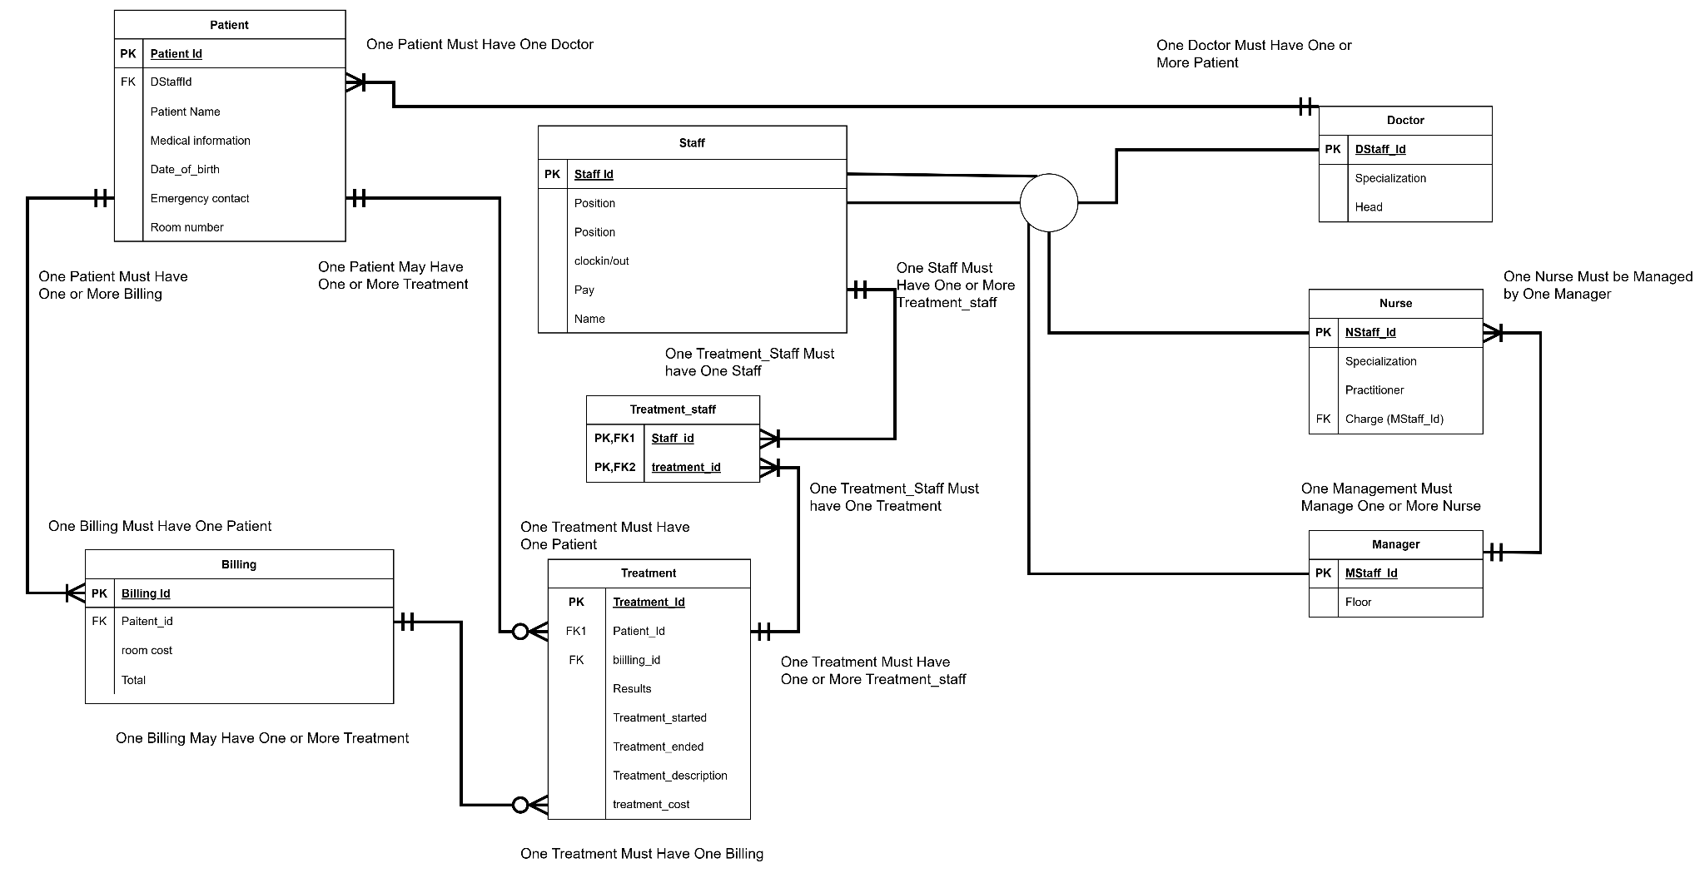
Diagram (ERD with Relational)

Slide 5
Cardinalities
Relationship | Entities Involved | Cardinality | Explanation
Patient – Billing | Patient to Billing | 1:M (One-to-Many) | One patient can have multiple billing records.
Patient – Treatment | Patient to Treatment | 1:M | One patient can receive multiple treatments.
Staff – Treatment | Staff to Treatment | 1:M | One staff member can administer multiple treatments.
Treatment – Treatment_Staff | Treatment to Treatment_Staff | 1:M | A treatment can involve multiple staff roles.
Staff – Treatment_Staff | Staff to Treatment_Staff | 1:M | A staff member can be part of many treatment assignments.
Staff – Doctor/Nurse/Manager | Staff to Doctor/Nurse/Manager | 1:1 (Disjoint Specialization) | Each staff member is exactly one of: Doctor, Nurse, or Manager.
Staff – Patient | Staff to Patient | M:N (via Treatment table) | Many staff can treat many patients (implied through Treatment entity).
Treatment – Billing | Treatment to Billing | 1:M | Each billing record is associated with multiple treatment.

Slide 6

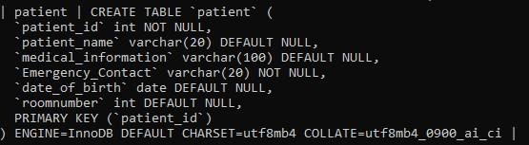
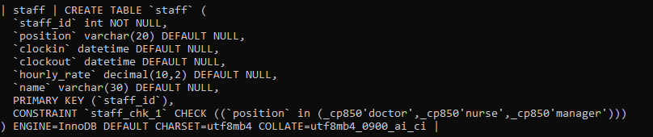
DDL
*Distraction*
Notes:
Things to point out: Normally we only use 11 digits for phone number taking into account the US country code being one we extended emergency contact to take in a varchar of 20 to include international numbers and since we’re not using any mathematical operations in there we used varchar rather than integers. Another thing we did was make emergency contact not null, this is so incase the hospital needs a guaranteed way to reach someone close to the patient for critical decisions, consent, or urgent updates.

Slide 7
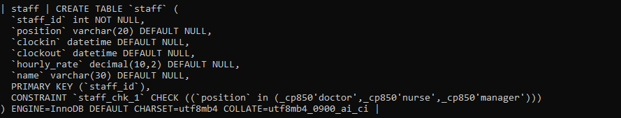
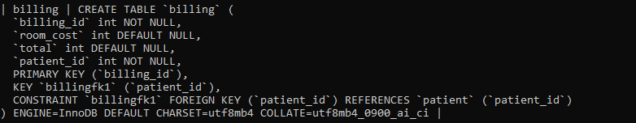
DDL pt2
Notes:
Things to keep in mind, we can use timestampdiff which is a function we found while looking up datetime datatype for things where we need date and time. And this basically as the name implies find the difference between the date and time. Which we could then use to multiply with hourly_rate to find how much that staff member makes

Slide 8

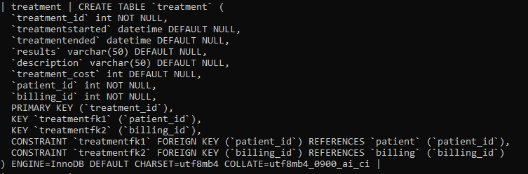
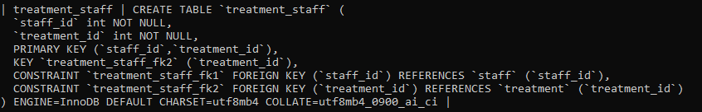
DDL pt3
*Distraction*

Slide 9
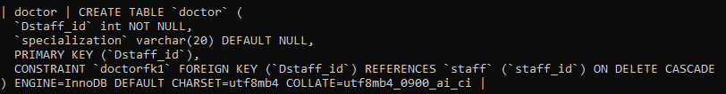
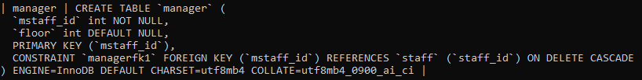
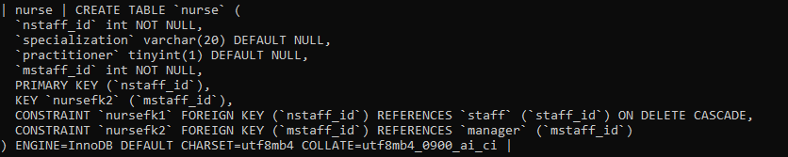
DDL pt4

Slide 10
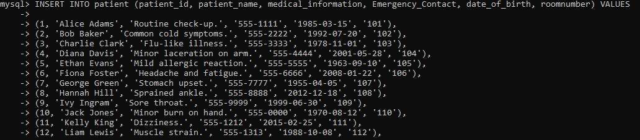

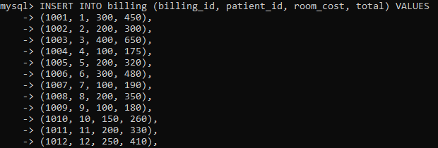
Inserting data
*Distraction*

Slide 11
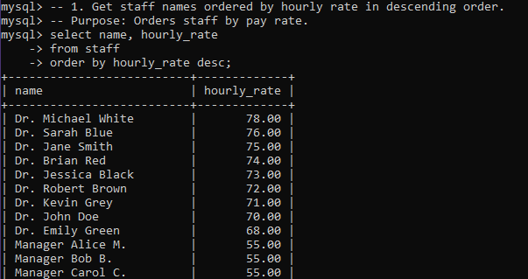
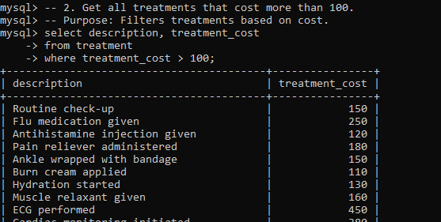
Queries

Slide 12
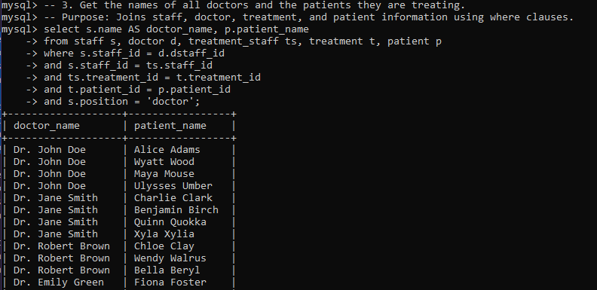

More queries
*Distraction*

Slide 13
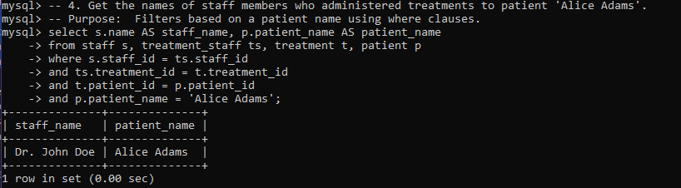

Even More Queries
*Distraction*

Slide 14
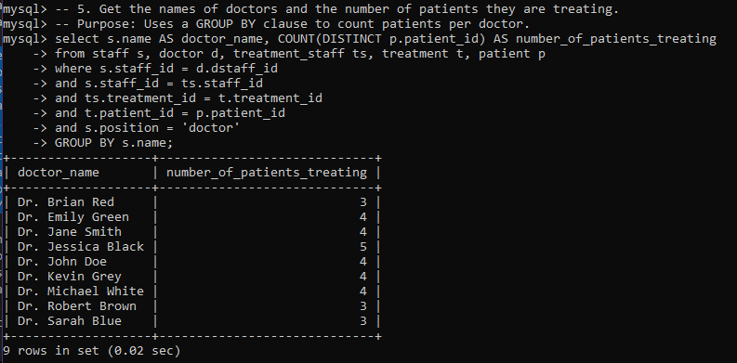
More queries ^ 2?

